Slide 1
Network Security II
Department of
York College of Pennsylvania

Slide 2
Chapter 6:
6.1 The Application Layer and DNS
6.2 Firewalls
6.3 Tunneling
6.4 Intrusion Detection
6.5 Wireless Networking

Slide 3
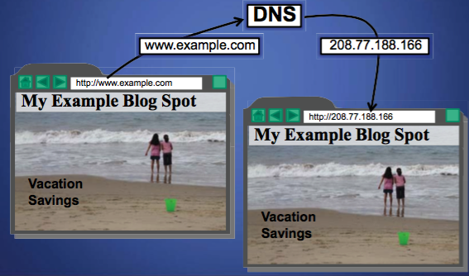
Domain Name System
The domain name system (DNS) is an application-layer protocol for mapping domain names to IP addresses

Slide 4
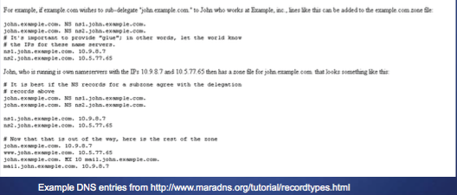
Domain Name System
DNS provides a distributed database over the internet that stores various resource records, including:
– Address (A) record: IP address associated with a host name
– Mail exchange(MX) record: mail server of a domain – Name server (NS) record: authoritative server for a domain

Slide 5
Name Servers
Domain names:
- Two or more labels, separated by dots (e.g., cs166.net)
– Rightmost label is the top-level domain (TLD)
Hierarchy of authoritative name servers
– Information about root domain
– Information about its subdomains (A records) or references to other name servers (NS records)
The authoritative name server hierarchy matches the domain hierarchy: root servers point to DNS servers for TLDs, etc.
Root servers, and servers for TLDs change infrequently
DNS servers refer to other DNS servers by name, not by IP: sometimes must bootstrap by providing an IP along with a name, called a glue record

Slide 6
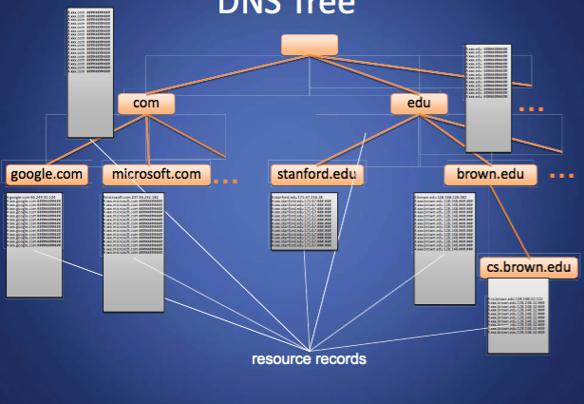
DNS Tree

Slide 7
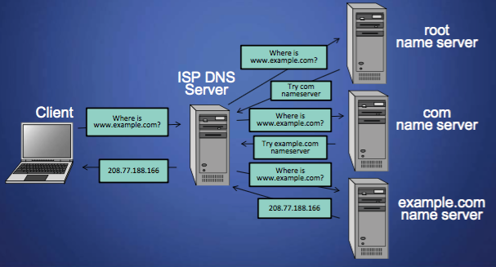
Name Resolution
Zone: collection of connected nodes with the same authoritative DNS server
Resolution method when answer not in cache:

Slide 8
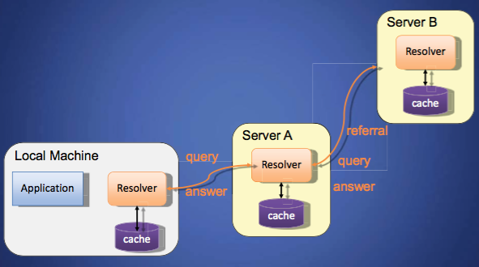
Recursive Name Resolution

Slide 9
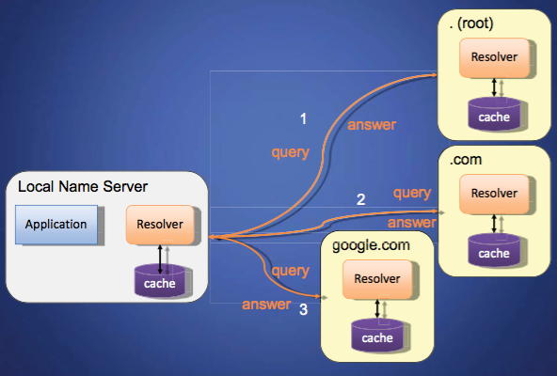
Iterative Name Resolution

Slide 10
Authoritative Name Servers
Control distributed among authoritative name servers (ANSs)
– Responsible for specific domains – Can designate other ANS for subdomains
ANS can be master or slave
– Master contains original zone table – Slaves are replicas, automatically updating
Makes DNS fault tolerant, automatically distributes load
ANS must be installed as a NS in parents' zone

Slide 11
Dynamic Resolution
Many large providers have more than one authoritative name server for a domain
Problem: need to locate the instance of domain geographically closest to user
Proposed solution: include first 3 octets of requester's IP in recursive requests to allow better service
Content distribution networks already do adaptive DNS routing

Slide 12
DNS Caching
There would be too much network traffic if a path in the DNS tree would be traversed for each query
– Root zone would be rapidly overloaded
DNS servers cache results for a specified amount of time
– Specified by ANS reply's time-to-live field
Operating systems and browsers also maintain resolvers and DNS caches
– View in Windows with command ipconfig/displaydns
– Associated privacy issues
DNS queries are typically issued over UDP on port 53
– 16-bit request identifier in payload

Slide 13
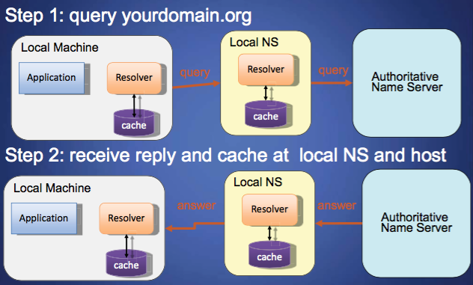
DNS Caching

Slide 14
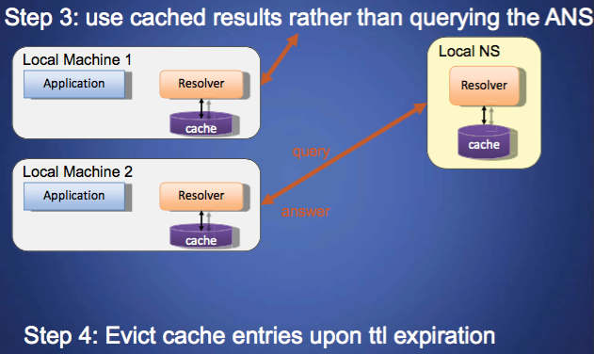
DNS Caching (con'd)

Slide 15
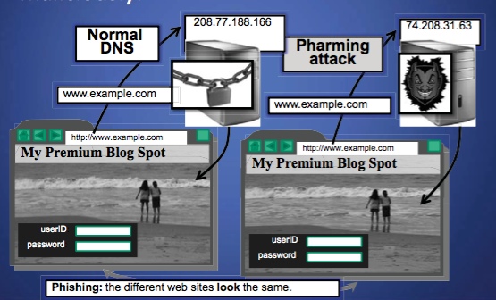
Pharming: DNS Hijacking
Changing IP associated with a server maliciously:

Slide 16
DNS Cache Poisoning
Basic idea: give DNS servers false records and get it cached
DNS uses a 16-bit request identifier to pair queries with answers
Cache may be poisoned when a name server:
– Disregards identifiers – Has predictable ids – Accepts unsolicited DNS records

Slide 17
DNS Cache Poisoning Prevention
Use random identifiers for queries
• Always check identifiers
• Port randomization for DNS requests
• Deploy DNSSEC
– Challenging because it is still being deployed and requires reciprocity

Slide 18
DNSSEC
Guarantees:
– Authenticity of DNS answer origin
– Integrity of reply – Authenticity of denial of existence
Accomplishes this by signing DNS replies at each step of the way
Uses public-key cryptography to sign responses
Typically use trust anchors, entries in the OS to bootstrap the process

Slide 19
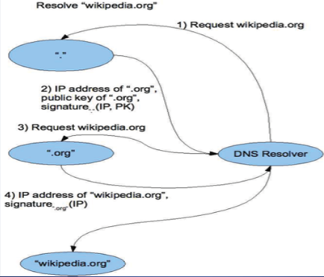
DNS Signing

Slide 20
DNSSEC Deployment
As the internet becomes regarded as critical infrastructure there is a push to secure DNS
NIST is in the process of deploying it on root servers now
May add considerable load to dns servers with packet sizes considerably larger than 512 byte size of UDP packets
There are political concerns with the US controlling the root level of DNS

Slide 21
Chapter 6:
6.1 The Application Layer and DNS
6.2 Firewalls
6.3 Tunneling
6.4 Intrusion Detection
6.5 Wireless Networking

Slide 22

Firewalls
A firewall is an integrated collection of security measures designed to prevent unauthorized electronic access to a networked computer system.
A network firewall is similar to firewalls in building construction, because in both cases they are intended to isolate one "network" or "compartment" from another.

Slide 23
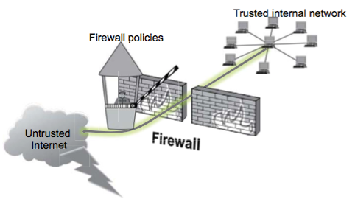
Firewall Policies
To protect private networks and individual machines from the dangers of the greater Internet, a firewall can be employed to filter incoming or outgoing traffic based on a predefined set of rules called firewall policies.

Slide 24
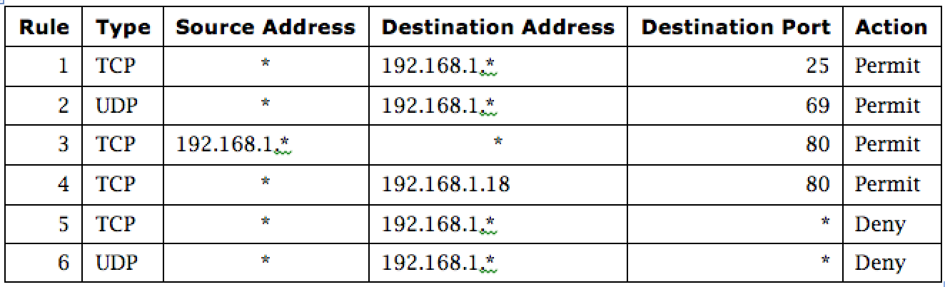
Firewall Security Policy
Notes:
In this example firewall configuration,
External traffic can reach the entire internal network on TCP/25 and UDP/69.
Internal traffic can go out to port 80 on the external network.
External traffic can reach TCP/80 on one internal server.
All other traffic from external to internal is disallowed.

Slide 25
Policy Actions
Packets flowing through a firewall can have one of three outcomes:
Accepted: permitted through the firewall
Dropped: not allowed through with no indication of failure
Rejected: not allowed through, accompanied by an attempt to inform the source that the packet was rejected
Policies used by the firewall to handle packets are based on several properties of the packets being inspected, including the protocol used, such as:
– TCP or UDP
– the source and destination IP addresses
– the source and destination ports
– the application-level payload of the packet (e.g., whether it contains a virus).

Slide 26
Blacklists and White Lists
There are two fundamental approaches to creating firewall policies (or rulesets) to effectively minimize vulnerability to the outside world while maintaining the desired functionality for the machines in the trusted internal network (or individual computer).
Blacklist approach
– All packets are allowed through except those that fit the rules defined
specifically in a blacklist.
– This type of configuration is more flexible in ensuring that service to the internal network is not disrupted by the firewall, but is naïve from a security perspective in that it assumes the network administrator can enumerate all of the properties of malicious traffic.
Whitelist approach
– A safer approach to defining a firewall ruleset is the default-deny policy, in which packets are dropped or rejected unless they are specifically allowed by the firewall.

Slide 27
Firewall Types
packet filters (stateless)
– If a packet matches the packet filter's set of rules, the packet filter will drop or accept it
"stateful" filters
– it maintains records of all connections passing through it and can determine if a packet is either the start of a new connection, a part of an existing connection, or is an invalid packet.
application layer
– It works like a proxy it can “understand” certain applications and protocols.
– It may inspect the contents of the traffic, blocking what it views as inappropriate content (i.e. websites, viruses, vulnerabilities, ...)

Slide 28
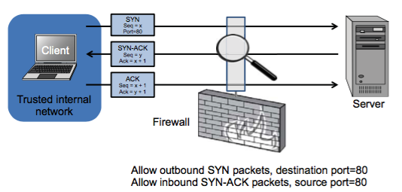
Stateless Firewalls
A stateless firewall doesn’t maintain any remembered context (or “state”) with respect to the packets it is processing. Instead, it treats each packet attempting to travel through it in isolation without considering packets that it has processed previously.

Slide 29
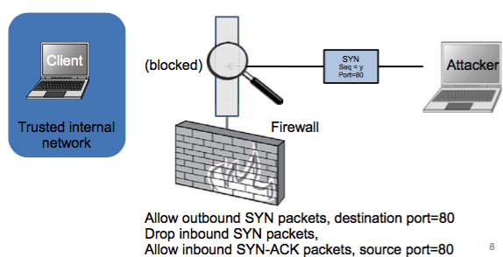
Stateless Restrictions
Stateless firewalls may have to be fairly restrictive in order to prevent most attacks.

Slide 30
Statefull Firewalls
Stateful firewalls can tell when packets are part of legitimate sessions originating within a trusted network.
Stateful firewalls maintain tables containing information on each active connection, including the IP addresses, ports, and sequence numbers of packets.
Using these tables, stateful firewalls can allow only inbound TCP packets that are in response to a connection initiated from within the internal network.

Slide 31
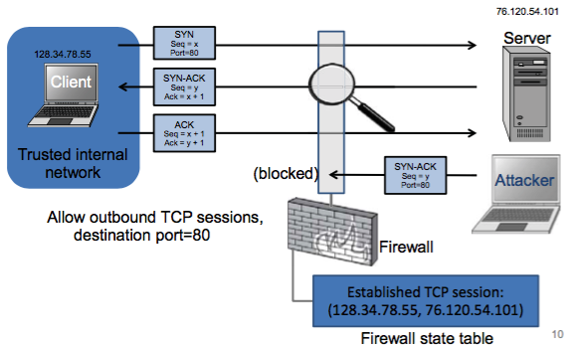
Statefull Firewall Example
Allow only requested TCP connections:

Slide 32
Chapter 6:
6.1 The Application Layer and DNS
6.2 Firewalls
6.3 Tunneling
6.4 Intrusion Detection
6.5 Wireless Networking

Slide 33
Tunnels
The contents of TCP packets are not normally encrypted, so if someone is eavesdropping on a TCP connection, he can often see the complete contents of the payloads in this session.
One way to prevent such eavesdropping without changing the software performing the communication is to use a tunneling protocol.
In such a protocol, the communication betweena client and server is automatically encrypted, so that useful eavesdropping is infeasible.

Slide 34
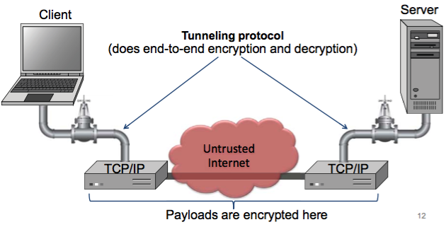
Tunneling Prevents Eavesdropping
Packets sent over the Internet are automatically encrypted.

Slide 35
Secure Shell (SSH)
Originally developed for UNIX but now available on most OSs
Provides an authenticated, encrypted path to the OS command line over the network
Replacement for insecure utilities such as Telnet, rlogin, and rsh
Protects against spoofing attacks and modification of data in communication

Slide 36
IPSec
IPSec defines a set of protocols to provide confidentiality and authenticity for IP packets
Each protocol can operate in one of two modes, transport mode or tunnel mode.
– In transport mode, additional IPsec header information is inserted before the data of the original packet, and only the payload of the packet is encrypted or authenticated.
– In tunnel mode, a new packet is constructed with IPsec header information, and the entire original packet, including its header, is encapsulated as the payload of the new packet.

Slide 37
Virtual Private Networking (VPN)
Virtual private networking (VPN) is a technology that allows private networks to be safely extended over long physical distances by making use of a public network, such as the Internet, as a means of transport.
VPN provides guarantees of data confidentiality, integrity, and authentication, despite the use of an untrusted network for transmission.
There are two primary types of VPNs, remote access VPN and site-to-site VPN.

Slide 38
Virtual Private Networks (VPN)
Notes:
In this picture, a VPN—an encrypted tunnel that provides confidentiality and integrity for communication between two sites over public networks—connects Office A to Office B over the Internet so they appear to their users as one seamless, private network. The VPN is terminated by firewalls at both ends, which is often the case in the real world.

Slide 39
Types of VPNs
Remote access VPNs allow authorized clients to access a private network that is referred to as an intranet.
– For example, an organization may wish to allow employees access to the company network remotely but make it appear as though they are local to their system and even the Internet itself.
– To accomplish this, the organization sets up a VPN endpoint, known as a network access server, or NAS. Clients typically install VPN client software on their machines, which handle negotiating a connection to the NAS and facilitating communication.
Site-to-site VPN solutions are designed to provide a secure bridge between two or more physically distant networks.
– Before VPN, organizations wishing to safely bridge their private networks purchased expensive leased lines to directly connect their intranets with cabling.

Slide 40
Chapter 6:
6.1 The Application Layer and DNS
6.2 Firewalls
6.3 Tunneling
6.4 Intrusion Detection
6.5 Wireless Networking

Slide 41
Intrusion Detection Systems
Intrusion
– Actions aimed at compromising the security of the target (confidentiality, integrity, availability of computing/networking resources)
Intrusion detection
– The identification through intrusion signatures and report of intrusion activities
Intrusion prevention
– The process of both detecting intrusion activities and managing automatic responsive actions throughout the network

Slide 42
Intrusion Detection Systems (IDS)
Notes:
IDSs complement preventative controls as a next line of defense. IDSs monitor activity to identify malicious or suspicious events. IDSs may
Monitor user and system activity
Audit system configurations for vulnerabilities and misconfigurations
Assess integrity of critical system and data files
Recognize known attack patterns in system activity
Identify abnormal activity through statistical analysis
Manage audit trails and highlight policy violations
Install and operate traps to record information about intruders

Slide 43
Intrusions
An IDS is designed to detect a number of threats, including the following:
masquerader: an attacker who is falsely using the identity and/or credentials of a legitimate user to gain access to a computer system or network
Misfeasor: a legitimate user who performs actions he is not authorized to do
Clandestine user: a user who tries to block or cover up his actions by deleting audit files and/or system logs
In addition, an IDS is designed to detect automated attacks and threats, including the following:
port scans: information gathering intended to determine which ports on a host are open for TCP connections
Denial-of-service attacks: network attacks meant to overwhelm a host and shut out legitimate accesses
Malware attacks: replicating malicious software attacks, such as Trojan horses, computer worms, viruses, etc.
ARP spoofing: an attempt to redirect IP traffic in a local-area network
DNS cache poisoning: a pharming attack directed at changing a host’s DNS cache to create a falsified domain-name/IP-address association

Slide 44
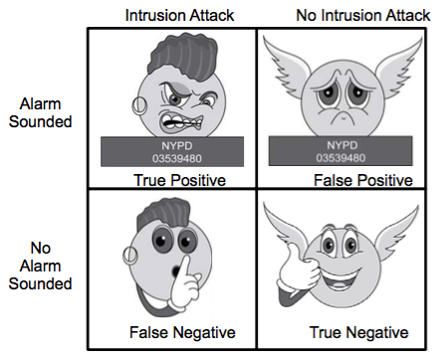
Possible Alarm Outcomes
Alarms can be sounded (positive) or not (negative)

Slide 45
Analysis Approaches
Anomaly detection
Signature/Heuristic detection
Involves the collection of data relating to the behavior of legitimate users over a period of time
Current observed behavior is analyzed to determine whether this behavior is that of a legitimate user or that of an intruder
Involves the collection of data relating to the behavior of legitimate users over a period of time
Current observed behavior is analyzed to determine whether this behavior is that of a legitimate user or that of an intruder

Slide 46
Anomaly Detection
A variety of classification approaches are used:
Statistical
Analysis of the observed behavior using univariate, multivariate, or time-series models of observed metrics
Knowledge based
Approaches use an expert system that classifies observed behavior according to a set of rules that model legitimate behavior
Machine-learning
Approaches automatically determine a suitable classification model from the training data using data mining techniques
Notes:
The anomaly detection approach involves first developing a model of legitimate
user behavior by collecting and processing sensor data from the normal operation
of the monitored system in a training phase. This may occur at distinct times, or
there may be a continuous process of monitoring and evolving the model over time.
Once this model exists, current observed behavior is compared with the model in
order to classify it as either legitimate or anomalous activity in a detection phase.
A variety of classification approaches are used, which [GARC09] broadly categorized
as:
• Statistical: Analysis of the observed behavior using univariate, multivariate,
or time-series models of observed metrics.
• Knowledge based: Approaches use an expert system that classifies observed
behavior according to a set of rules that model legitimate behavior.
• Machine-learning: Approaches automatically determine a suitable classification
model from the training data using data mining techniques.
They also note two key issues that affect the relative performance of these alternatives,
being the efficiency and cost of the detection process.
The monitored data is first parameterized into desired standard metrics that
will then be analyzed. This step ensures that data gathered from a variety of possible
sources is provided in standard form for analysis.
Statistical approaches use the captured sensor data to develop a statistical
profile of the observed metrics. The earliest approaches used univariate models,
where each metric was treated as an independent random variable. However this
was too crude to effectively identify intruder behavior. Later, multivariate models
considered correlations between the metrics, which better levels of discrimination
observed. Time-series models use the order and time between observed events to
better classify the behavior. The advantages of these statistical approaches include
their relative simplicity and low computation cost, and lack of assumptions about
behavior expected. Their disadvantages include the difficulty in selecting suitable
metrics to obtain a reasonable balance between false positives and false negatives,
and that not all behaviors can be modeled using these approaches.
Knowledge based approaches classify the observed data using a set of rules.
These rules are developed during the training phase, usually manually, to characterize
the observed training data into distinct classes. Formal tools may be used to
describe these rules, such as a finite-state machine or a standard description language.
They are then used to classify the observed data in the detection phase. The
advantages of knowledge-based approaches include their robustness and flexibility.
Their main disadvantage is the difficulty and time required to develop high-quality
knowledge from the data, and the need for human experts to assist with this process.
Machine-learning approaches use data mining techniques to automatically
develop a model using the labeled normal training data. This model is then able
to classify subsequently observed data as either normal or anomalous. A key disadvantage
is that this process typically requires significant time and computational
resources. Once the model is generated however, subsequent analysis is generally
fairly efficient.
A variety of machine-learning approaches have been tried, with varying success.
These include:
• Bayesian networks: Encode probabilistic relationships among observed metrics.
• Markov models: Develop a model with sets of states, some possibly hidden,
interconnected by transition probabilities.
• Neural networks: Simulate human brain operation with neurons and synapse
between them, that classify observed data.
• Fuzzy logic: Uses fuzzy set theory where reasoning is approximate, and can
accommodate uncertainty.
• Genetic algorithms: Uses techniques inspired by evolutionary biology, including
inheritance, mutation, selection and recombination, to develop classification
rules.
• Clustering and outlier detection: Group the observed data into clusters based
on some similarity or distance measure, and then identify subsequent data as
either belonging to a cluster or as an outlier.
The advantages of the machine-learning approaches include their flexibility, adaptability,
and ability to capture interdependencies between the observed metrics.
Their disadvantages include their dependency on assumptions about accepted
behavior for a system, their currently unacceptably high false alarm rate, and their
high resource cost.
A key limitation of anomaly detection approaches used by IDSs, particularly
the machine-learning approaches, is that they are generally only trained with legitimate
data, unlike many of the other applications surveyed in [CHAN09] where
both legitimate and anomalous training data is used. The lack of anomalous training
data, which occurs given the desire to detect currently unknown future attacks,
limits the effectiveness of some of the techniques listed above.

Slide 47
Signature or Heuristic Detection
Signature approaches
Match a large collection of known patterns of malicious data against data stored on a system or in transit over a network
The signatures need to be large enough to minimize the false alarm rate, while still detecting a sufficiently large fraction of malicious data
Widely used in anti-virus products, network traffic scanning proxies, and in NIDS
Rule-based heuristic identification
Involves the use of rules for identifying known penetrations or penetrations that would exploit known weaknesses
Rules can also be defined that identify suspicious behavior, even when the behavior is within the bounds of established patterns of usage
Typically rules used are specific
SNORT is an example of a rule-based NIDS
Notes:
Signature or heuristic techniques detect intrusion by observing events in the system
and applying either a set of signature patterns to the data, or a set of rules that
characterize the data, leading to a decision regarding whether the observed data
indicates normal or anomalous behavior.
Signature approaches match a large collection of known patterns of malicious
data against data stored on a system or in transit over a network. The signatures
need to be large enough to minimize the false alarm rate, while still detecting a
sufficiently large fraction of malicious data. This approach is widely used in antivirus
products, in network traffic scanning proxies, and in NIDS. The advantages
of this approach include the relatively low cost in time and resource use, and its
wide acceptance. Disadvantages include the significant effort required to constantly
identify and review new malware to create signatures able to identify it, and the
inability to detect zero-day attacks for which no signatures exist.
Rule-based heuristic identification involves the use of rules for identifying
known penetrations or penetrations that would exploit known weaknesses. Rules
can also be defined that identify suspicious behavior, even when the behavior is
within the bounds of established patterns of usage. Typically, the rules used in
these systems are specific to the machine and operating system. The most fruitful
approach to developing such rules is to analyze attack tools and scripts collected on
the Internet. These rules can be supplemented with rules generated by knowledgeable
security personnel. In this latter case, the normal procedure is to interview
system administrators and security analysts to collect a suite of known penetration
scenarios and key events that threaten the security of the target system.
The SNORT system, which we discuss later in Section 8.9 is an example of a
rule-based NIDS. A large collection of rules exists for it to detect a wide variety of
network attacks.

Slide 48
Host-Based IPS (HIPS)
Can make use of either signature/heuristic or anomaly detection techniques to identify attacks
Signature: focus is on the specific content of application network traffic, or of sequences of system calls, looking for patterns that have been identified as malicious
Anomaly: IPS is looking for behavior patterns that indicate malware
Examples of the types of malicious behavior addressed by a HIPS include:
Modification of system resources
Privilege-escalation exploits
Buffer-overflow exploits
Access to e-mail contact list
Directory traversal
Notes:
A host-based IPS (HIPS) can make use of either signature/heuristic or anomaly
detection techniques to identify attacks. In the former case, the focus is on the specific
content of application network traffic, or of sequences of system calls, looking
for patterns that have been identified as malicious. In the case of anomaly detection,
the IPS is looking for behavior patterns that indicate malware. Examples of the
types of malicious behavior addressed by a HIPS include the following:
• Modification of system resources: Rootkits, Trojan horses, and backdoors
operate by changing system resources, such as libraries, directories, registry
settings, and user accounts.
• Privilege-escalation exploits: These attacks attempt to give ordinary users
root access.
• Buffer-overflow exploits: These attacks are described in Chapter 10 .
• Access to e-mail contact list: Many worms spread by mailing a copy of themselves
to addresses in the local system’s e-mail address book.
• Directory traversal: A directory traversal vulnerability in a Web server allows
the hacker to access files outside the range of what a server application user
would normally need to access.
Attacks such as these result in behaviors that can be analyzed by a HIPS. The
HIPS capability can be tailored to the specific platform. A set of general-purpose
tools may be used for a desktop or server system. Some HIPS packages are designed
to protect specific types of servers, such as Web servers and database servers. In this
case, the HIPS looks for particular application attacks.
In addition to signature and anomaly-detection techniques, a HIPS can use
a sandbox approach. Sandboxes are especially suited to mobile code, such as Java
applets and scripting languages. The HIPS quarantines such code in an isolated
system area, then runs the code and monitors its behavior. If the code violates
predefined policies or matches predefined behavior signatures, it is halted and
prevented from executing in the normal system environment.
[ROBB06a] lists the following as areas for which a HIPS typically offers desktop
protection:
• System calls: The kernel controls access to system resources such as memory,
I/O devices, and processor. To use these resources, user applications invoke
system calls to the kernel. Any exploit code will execute at least one system
call. The HIPS can be configured to examine each system call for malicious
characteristics.
• File system access: The HIPS can ensure that file access system calls are not
malicious and meet established policy.
System registry settings: The registry maintains persistent configuration
information about programs and is often maliciously modified to extend the
life of an exploit. The HIPS can ensure that the system registry maintains its
integrity.
• Host input/output: I/O communications, whether local or network based, can
propagate exploit code and malware. The HIPS can examine and enforce
proper client interaction with the network and its interaction with other
devices.
Many industry observers see the enterprise endpoint,
including desktop and laptop systems, as now the main target for hackers and
criminals, more so than network devices [ROBB06b]. Thus, security vendors are
focusing more on developing endpoint security products. Traditionally, endpoint
security has been provided by a collection of distinct products, such as antivirus,
antispyware, antispam, and personal firewalls. The HIPS approach is an effort to
provide an integrated, single-product suite of functions. The advantages of the
integrated HIPS approach are that the various tools work closely together, threat
prevention is more comprehensive, and management is easier.
It may be tempting to think that endpoint security products such as HIPS,
if sophisticated enough, eliminate or at least reduce the need for network-level
devices. For example, the San Diego Supercomputer Center reports that over a
four-year period, there were no intrusions on any of its managed machines, in a
configuration with no firewalls and just endpoint security protection [SING03].
Nevertheless, a more prudent approach is to use HIPS as one element in a strategy
that involves network-level devices, such as either firewalls or network-based
IPSs.

Slide 49
Network-Based IPS (NIPS)
Inline NIDS with the authority to modify or discard packets and tear down TCP connections
Makes use of signature/heuristic detection and anomaly detection
May provide flow data protection
Requires that the application payload in a sequence of packets be reassembled
Methods used to identify malicious packets:
Pattern matching
Stateful matching
Protocol anomaly
Traffic anomaly
Statistical anomaly
Notes:
A network-based IPS (NIPS) is in essence an inline NIDS with the authority to
discard packets and tear down TCP connections. As with a NIDS, a NIPS makes use
of techniques such as signature detection and anomaly detection.
Among the techniques used in a NIPS but not commonly found in a firewall
is flow data protection. This requires that the application payload in a sequence
of packets be reassembled. The IPS device applies filters to the full content of the
flow every time a new packet for the flow arrives. When a flow is determined to be
malicious, the latest and all subsequent packets belonging to the suspect flow are
dropped.
In terms of the general methods used by a NIPS device to identify malicious
packets, the following are typical:
• Pattern matching: Scans incoming packets for specific byte sequences (the
signature) stored in a database of known attacks
• Stateful matching: Scans for attack signatures in the context of a traffic stream
rather than individual packets
• Protocol anomaly: Looks for deviation from standards set forth in RFCs
Traffic anomaly: Watches for unusual traffic activities, such as a flood of UDP
packets or a new service appearing on the network
• Statistical anomaly: Develops baselines of normal traffic activity and throughput,
and alerts on deviations from those baselines

Slide 50
Honeypots
Decoy systems designed to:
Lure a potential attacker away from critical systems
Collect information about the attacker’s activity
Encourage the attacker to stay on the system long enough for administrators to respond
Systems are filled with fabricated information that a legitimate user of the system wouldn’t access
Resources that have no production value
Therefore incoming communication is most likely a probe, scan, or attack
Initiated outbound communication suggests that the system has probably been compromised
Notes:
A further component of intrusion detection technology is the honeypot. Honeypots
are decoy systems that are designed to lure a potential attacker away from critical
systems. Honeypots are designed to:
• Divert an attacker from accessing critical systems.
• Collect information about the attacker’s activity.
• Encourage the attacker to stay on the system long enough for administrators
to respond.
These systems are filled with fabricated information designed to appear valuable
but that a legitimate user of the system would not access. Thus, any access to
the honeypot is suspect. The system is instrumented with sensitive monitors and
event loggers that detect these accesses and collect information about the attacker’s
activities. Because any attack against the honeypot is made to seem successful,
administrators have time to mobilize and log and track the attacker without ever
exposing productive systems.
The honeypot is a resource that has no production value. There is no legitimate
reason for anyone outside the network to interact with a honeypot. Thus, any
attempt to communicate with the system is most likely a probe, scan, or attack. Conversely,
if a honeypot initiates outbound communication, the system has probably
been compromised.

Slide 51
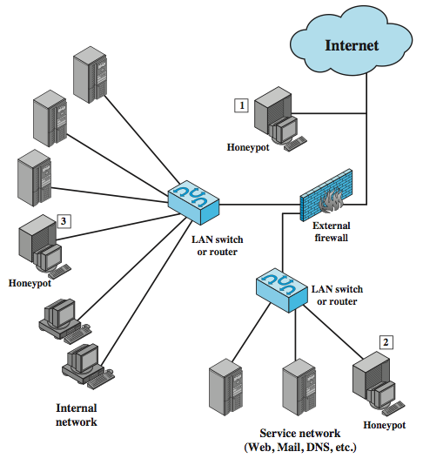
Honeypot Deployment
Notes:
Honeypots can be deployed in a variety of locations. Figure 8.8 illustrates
some possibilities. The location depends on a number of factors, such as the type
of information the organization is interested in gathering and the level of risk that
organizations can tolerate to obtain the maximum amount of data.
A honeypot outside the external firewall ( location 1 ) is useful for tracking
attempts to connect to unused IP addresses within the scope of the network. A honeypot
at this location does not increase the risk for the internal network. The danger
of having a compromised system behind the firewall is avoided. Further, because
the honeypot attracts many potential attacks, it reduces the alerts issued by the firewall
and by internal IDS sensors, easing the management burden. The disadvantage
of an external honeypot is that it has little or no ability to trap internal attackers,
especially if the external firewall filters traffic in both directions.
The network of externally available services, such as Web and mail, often
called the DMZ (demilitarized zone), is another candidate for locating a honeypot
( location 2 ). The security administrator must assure that the other systems in the
DMZ are secure against any activity generated by the honeypot. A disadvantage of
this location is that a typical DMZ is not fully accessible, and the firewall typically
blocks traffic to the DMZ the attempts to access unneeded services. Thus, the firewall
either has to open up the traffic beyond what is permissible, which is risky, or
limit the effectiveness of the honeypot.
A fully internal honeypot ( location 3 ) has several advantages. Its most important
advantage is that it can catch internal attacks. A honeypot at this location can
also detect a misconfigured firewall that forwards impermissible traffic from the
Internet to the internal network. There are several disadvantages. The most serious
of these is if the honeypot is compromised so that it can attack other internal
systems. Any further traffic from the Internet to the attacker is not blocked by the
firewall because it is regarded as traffic to the honeypot only. Another difficulty for
this honeypot location is that, as with location 2, the firewall must adjust its filtering
to allow traffic to the honeypot, thus complicating firewall configuration and potentially
compromising the internal network.

Slide 52
Security Information and Event Management (SIEM)
Notes:
SIEMs are software systems that collect security-relevant data—usually audit logs—from a variety of hardware and software products to create a unified security dashboard for security operations center personnel. Without an SIEM, analysts would need to log into each device individually on a constant basis and would have to manually correlate events on one system against events on another, which is impossible on any reasonably sized system. SIEMs range in functionality from simple ones that allow for basic search and alerting to complex platforms that allow for completely custom dashboards, reports, alerts, and correlation.

Slide 53
Chapter 6:
6.1 The Application Layer and DNS
6.2 Firewalls
6.3 Tunneling
6.4 Intrusion Detection
6.5 Wireless Networking

Slide 54
Welcome to Wireless
Radio waves
– No need to be physically plugged into the network
– Remote access
Coverage
– Personal Area Network (PAN)
– Local Area Network (LAN)
– Metropolitan Area Network (MAN)
Security concerns
Radio signals leaking outside buildings
Detection of unauthorized devices
Intercepting wireless communications
Man-in-the-middle attacks
Verification of users
Restricting access

Slide 55
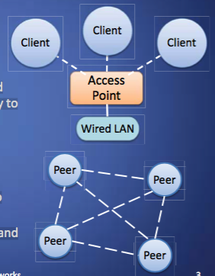
Types of Wireless Networks
Infrastructure
– Client machines establish a radio connection to a special network device, called access point
– Access points connected to a wired network, which provides a gateway to the internet
– Most common type of wireless network
Peer-to-peer
– Multiple peer machines connect to each other
– Typically used in ad-hoc networks and internet connection sharing

Slide 56
SSID
Multiple wireless networks can coexist
– Each network is identified by a 32-character service set ID (SSID)
– Typical default SSID of access point is manufacturer’s name
– SSIDs often broadcasted to enable discovery of the network by prospective clients
SSIDs are not signed, thus enabling a simple spoofing attack
– Place a rogue access point in a public location (e.g., cafe, airport)
– Use the SSID of an ISP
– Setup a login page similar to the one of the ISP
– Wait for clients to connect to rogue access point and authenticate
– Possibly forward session to ISP network
– Facilitated by automatic connection defaults
Notes:
Database: A collection of data and a set of rules that organize the data by specifying certain relationships among the data
Database administrator: Person who defines the rules that organize the data and controls who should have access to what parts of the data
Database management system: The system through which users interact with the database
Record: One related group of data
Field/element: Elementary data items that make up a record (e.g., name, address, city)
Schema: Logical structure of a database
Subschema: The portion of a database a given user has access to
Attribute: A column in a database
Relation: A set of database columns

Slide 57
Eavesdropping and Spoofing
All wireless network traffic can be eavesdropped
MAC-based authentication typically used to identify approved machines in corporate network
MAC spoofing attacks possible, as in wired networks
Sessions kept active after brief disconnects
If ISP client does not explicitly end a session, MAC spoofing allows to take over that session

Slide 58
Captive Portal
Protocol
– DHCP provides IP address
– Name server maps everything to authentication server
– Firewall blocks all other traffic
– Any URL is redirected to authentication page
– After authentication, regular network services reinstated
– Client identified by MAC address
– Used by wireless ISPs
Security Issues
- A MAC spoofing and session stealing attack may be performed if client does not actively disconnect
- A tunneling attack can bypass captive portal if DNS traffic beyond firewall is not blocked before authentication

Slide 59
Wardriving and Warchalking
Driving around looking for wireless local area networks
Some use GPS devices to log locations, post online
Software such as NetStumbler for Windows, KisMac for Macs and Kismet for Linux are easily available online
Use antennas to increase range
Legality is unclear when no information is transmitted, and no network services are used
Warchalking involves leaving chalk marks (derived from hobo symbols) on the side walk marking wireless networks and associated information

Slide 60
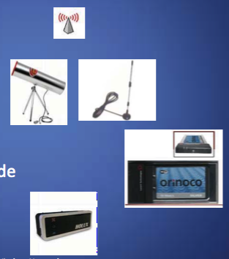
Wardriving Tools
Netstumbler wifi scanner
Antenna for db gain
Wireless card with plug and monitor mode
GPS(optional)

Slide 61
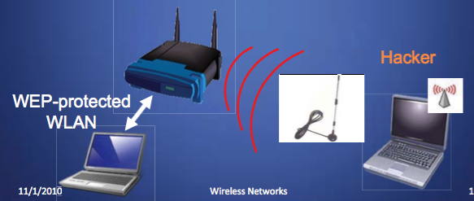
Wardriving Setup
The access point and client are using WEP encryption
The hacker is sniffing using wardriving tools

Slide 62
Slow Attack: WEP Sniffing
To crack a 64-bit WEP key you can capture:
– 50,000 to 200,000 packets containing Initialization Vectors (IVs)
– Only about 1⁄4 of the packets contain IVs – So you need 200,000 to 800,000 packets
It can take a long time (typically several hours or even days) to capture that many packets
Notes:
The basic building block of a relational database is a table of data, consisting of rows
and columns, similar to a spreadsheet. Each column holds a particular type of data,
while each row contains a specific value for each column. Ideally, the table has at
least one column in which each value is unique, thus serving as an identifier for a
given entry. For example, a typical telephone directory contains one entry for each
subscriber, with columns for name, telephone number, and address. Such a table is
called a flat file because it is a single two-dimensional (rows and columns) file. In a
flat file, all of the data are stored in a single table. For the telephone directory, there
might be a number of subscribers with the same name, but the telephone numbers
should be unique, so that the telephone number serves as a unique identifier for a
row. However, two or more people sharing the same phone number might each be
listed in the directory. To continue to hold all of the data for the telephone directory
in a single table and to provide for a unique identifier for each row, we could require
a separate column for secondary subscriber, tertiary subscriber, and so on. The result
would be that for each telephone number in use, there is a single entry in the table.
The drawback of using a single table is that some of the column positions for
a given row may be blank (not used). Also, any time a new service or new type of
information is incorporated in the database, more columns must be added and the
database and accompanying software must be redesigned and rebuilt.
The relational database structure enables the creation of multiple tables
tied together by a unique identifier that is present in all tables.
Users and applications use a relational query language to access the database.
The query language uses declarative statements rather than the procedural
instructions of a programming language. In essence, the query language allows
the user to request selected items of data from all records that fit a given set of
criteria. The software then figures out how to extract the requested data from one
or more tables. For example, a telephone company representative could retrieve a
subscriber’s billing information as well as the status of special services or the latest
payment received, all displayed on one screen.

Slide 63
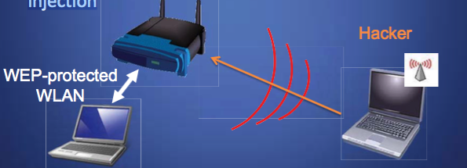
Fast Attack: Packet Injection
The hacker injects packets to create a more “interesting” packet
Special wireless card driver is necessary to perform injection
Notes:
Structured Query Language (SQL) is a standardized language that can be used to
define schema, manipulate, and query data in a relational database. There are several
versions of the ANSI/ISO standard and a variety of different implementations,
but all follow the same basic syntax and semantics.
SQL statements
can be used to create tables, insert and delete data in tables, create views, and
retrieve data with query statements.

Slide 64
Questions

